Slide 1

Energy Efficiency
•Group 2
•Meghanath Somarowthu
•Sai Sinduri Vangala
•Uday Suhas Nakkapalli
•Chenna Keshav Chinthakindi
Professor: Donald Harter

Slide 2
Overview
Introduction
Visualizations
Statistical Analysis
Modelling Analysis
Lesson learned

Slide 3

Introduction
We performed energy analysis using 12 different building shapes simulated in Ecotect.

Slide 4


Data Set
Relative Compactness – Continuous
Surface Area- Continuous
Wall Area - Continuous
Roof Area - Continuous
Overall Height- - Continuous
Orientation – Categorical and Discrete
Glazing Area- - Continuous
Glazing Area Distribution -Categorical and Discrete
The buildings differ with respect to the glazing area, the glazing area distribution, and the orientation, amongst other parameters.
The aim is to use the eight features to predict the responses.
Cooling load

Slide 5

Visualizations

Slide 6
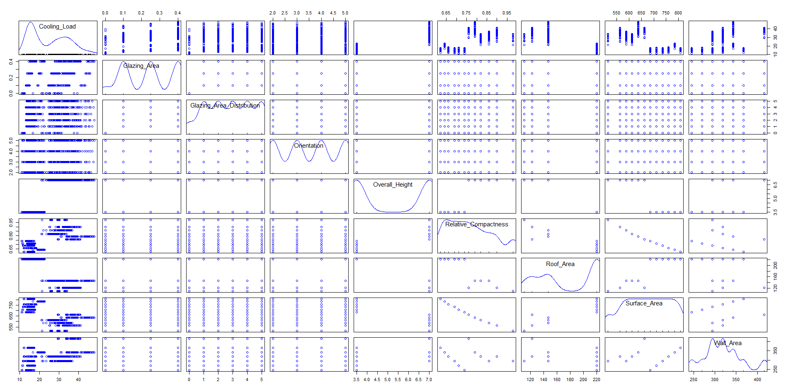
Scatterplot matrix using Rcmdr

Slide 7
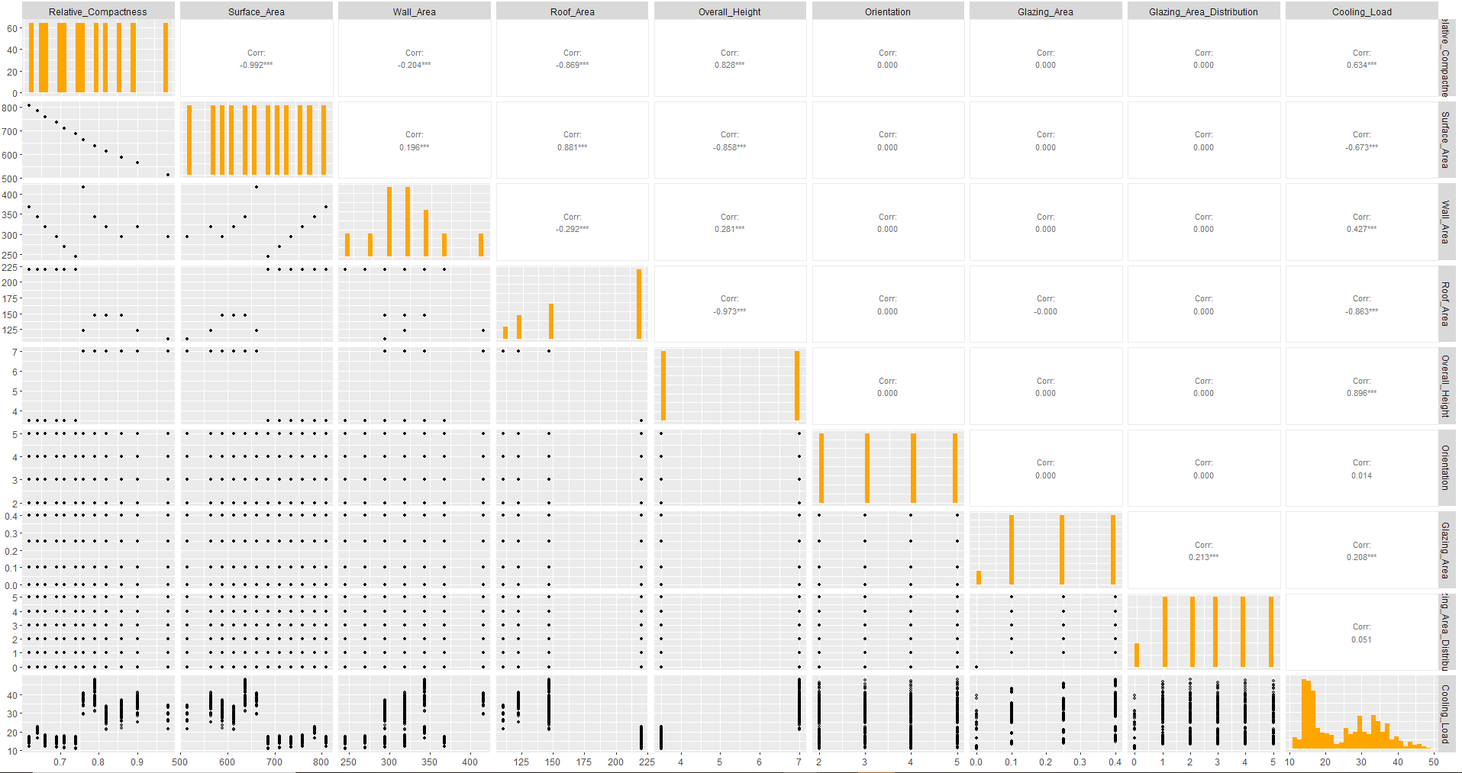
Using R studio

Slide 8
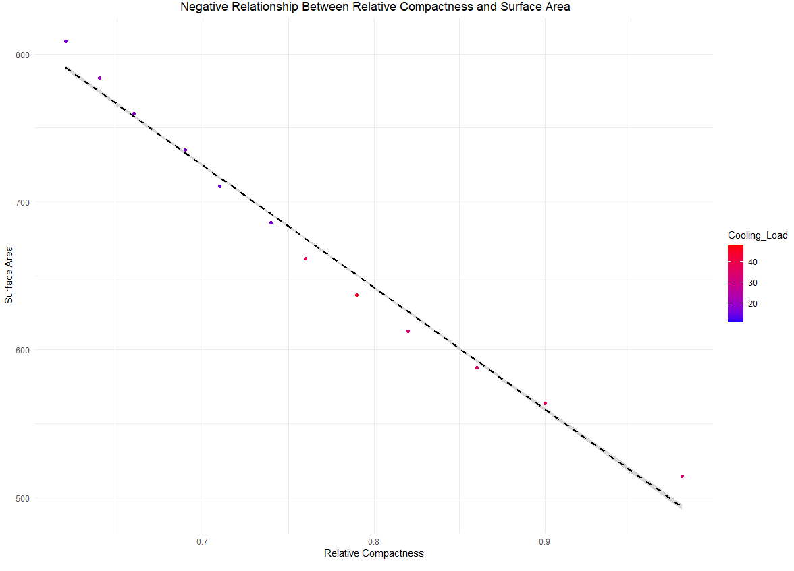
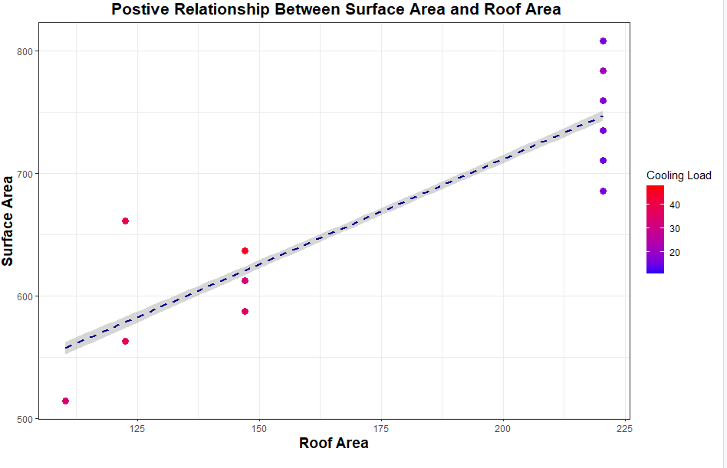
Relationships
Relative compactness and Surface Area
Roof Area and Surface Area

Slide 9

Relationship | Negative / Positive | Correlation
Overall height and Roof Area | Negative | -0.973
Roof area and Relative Compactness | Negative | -0.869
Overall height and Relative Compactness | Positive | 0.828
Overall height and Surface Area | Negative | -0.858

Slide 10


Histograms

Slide 11
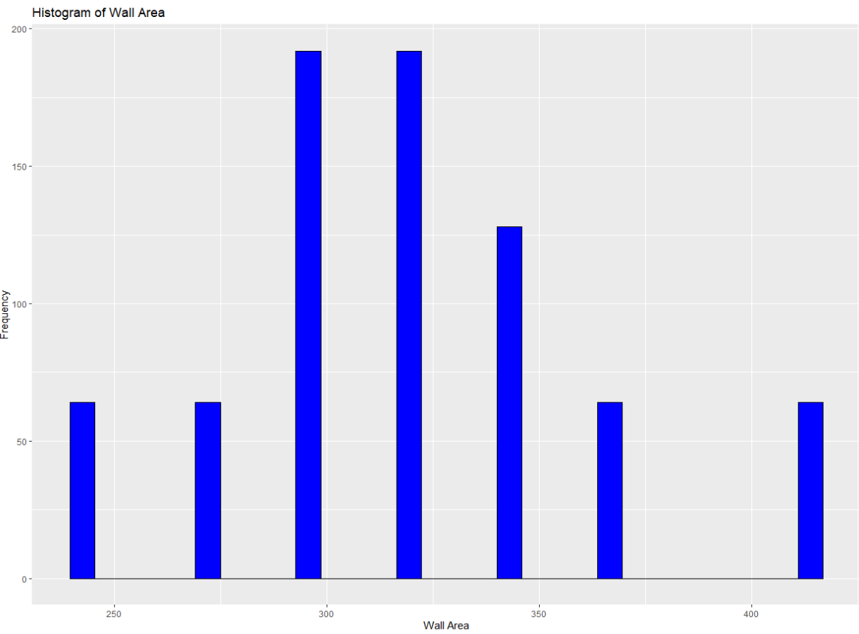
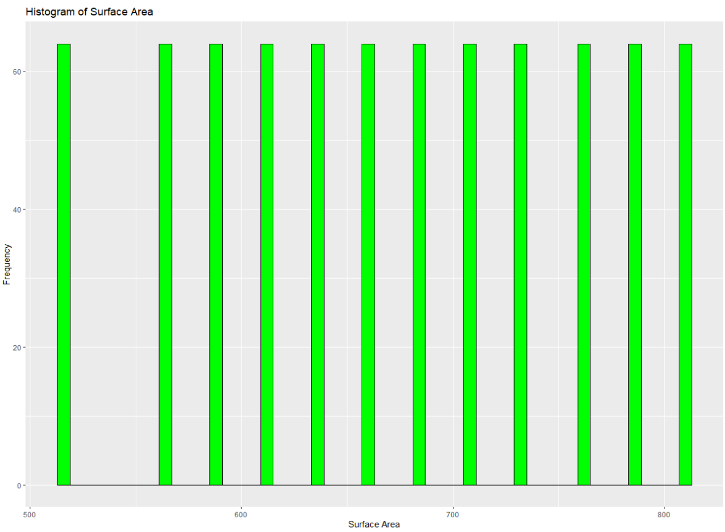
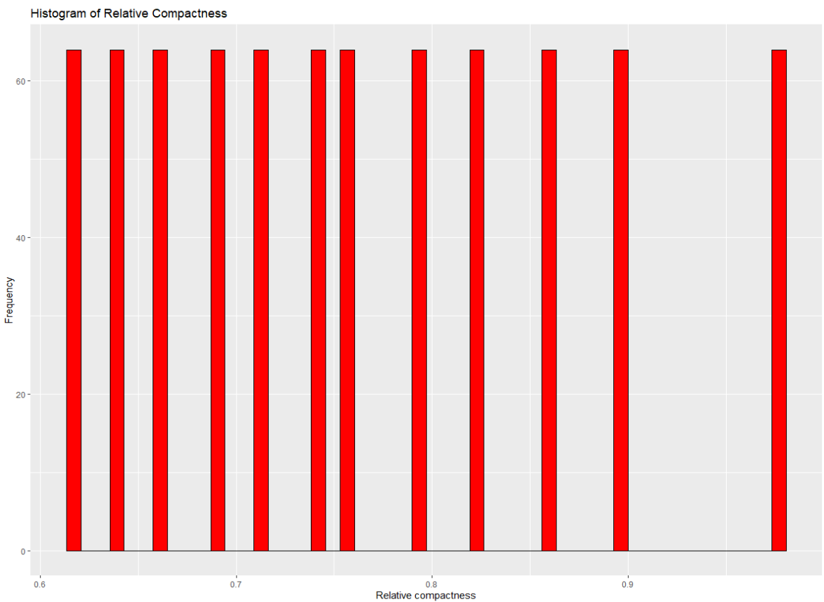
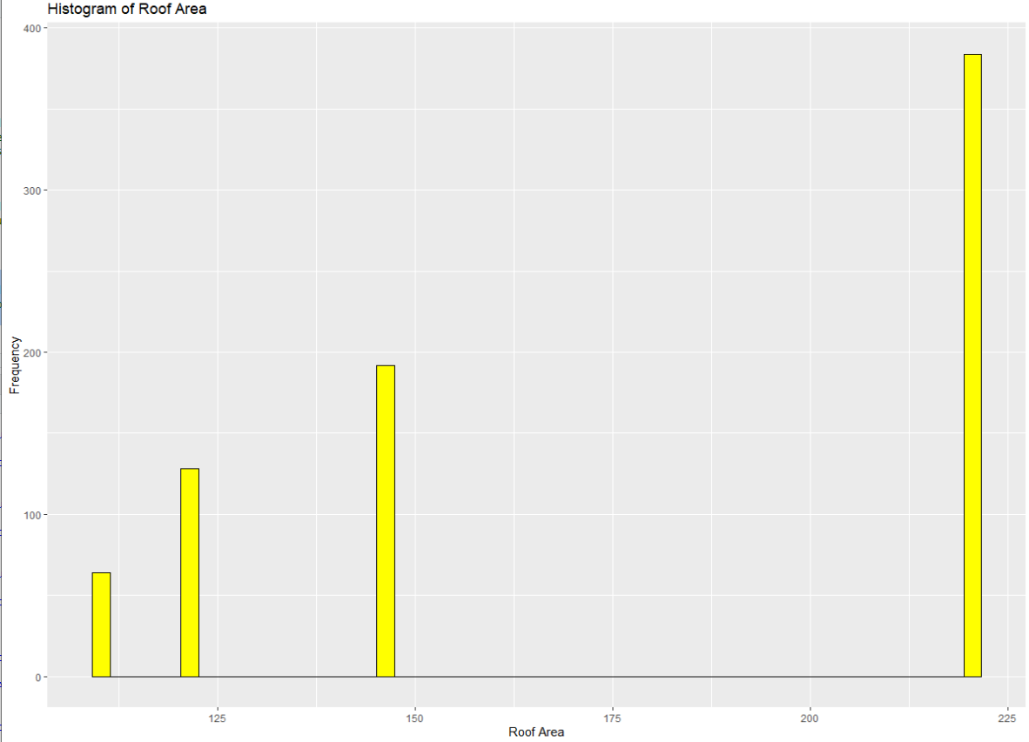

Slide 12
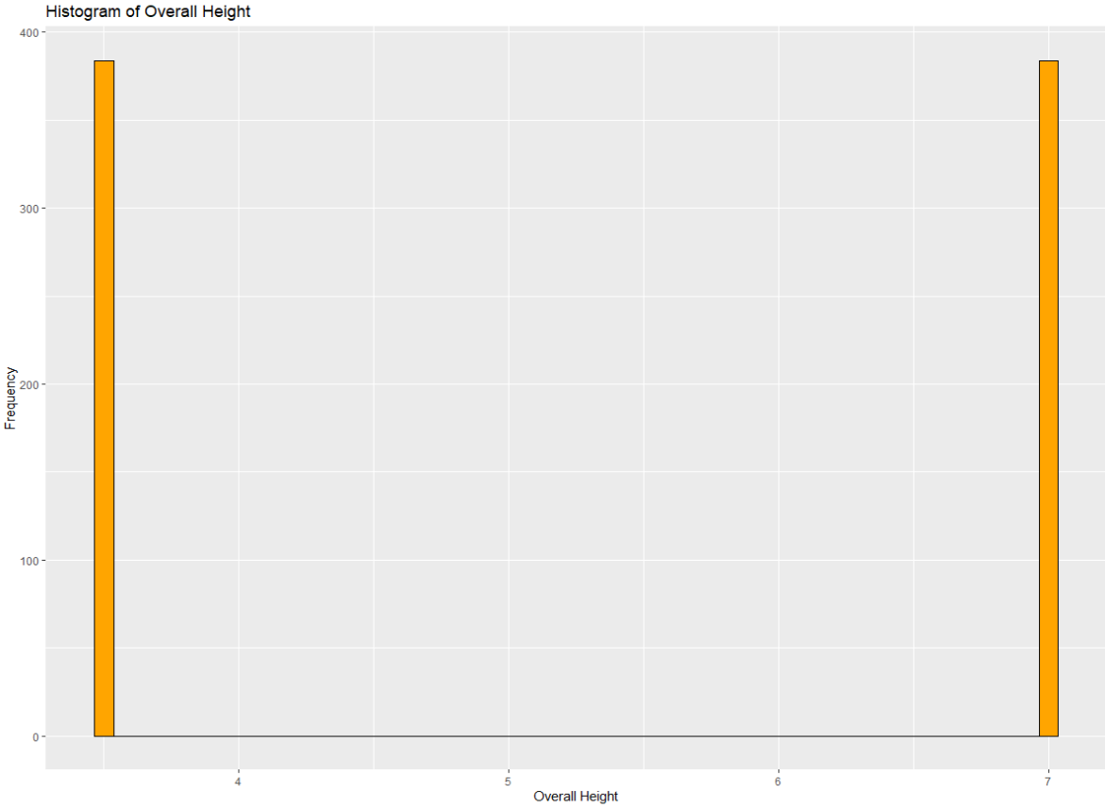
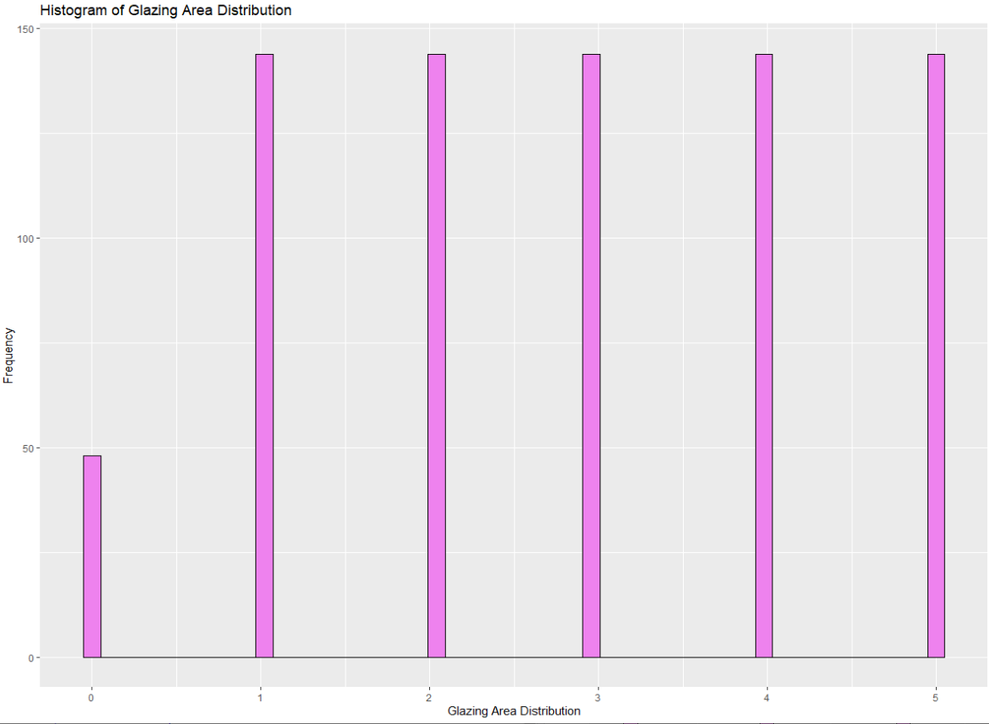
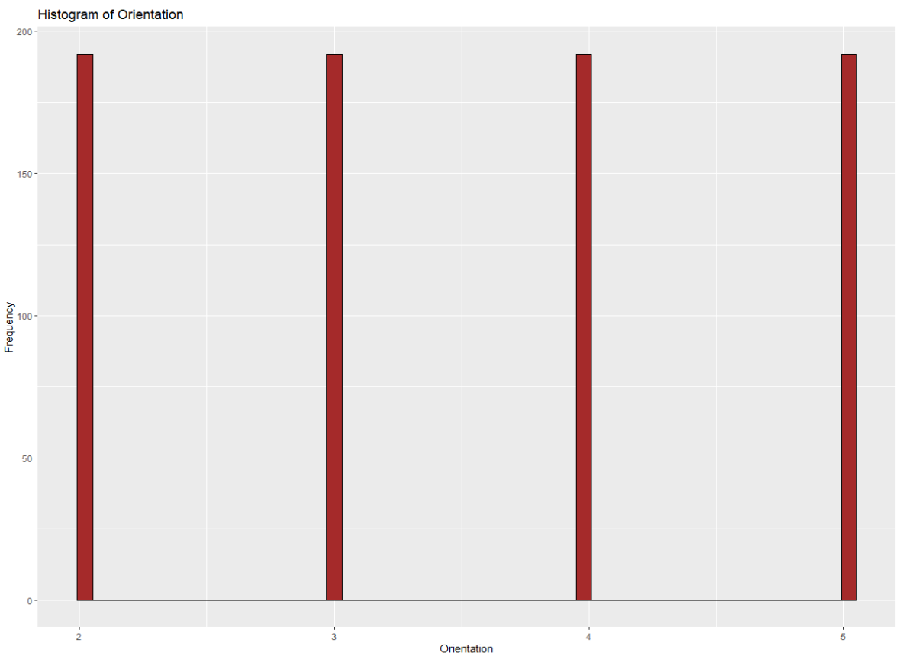
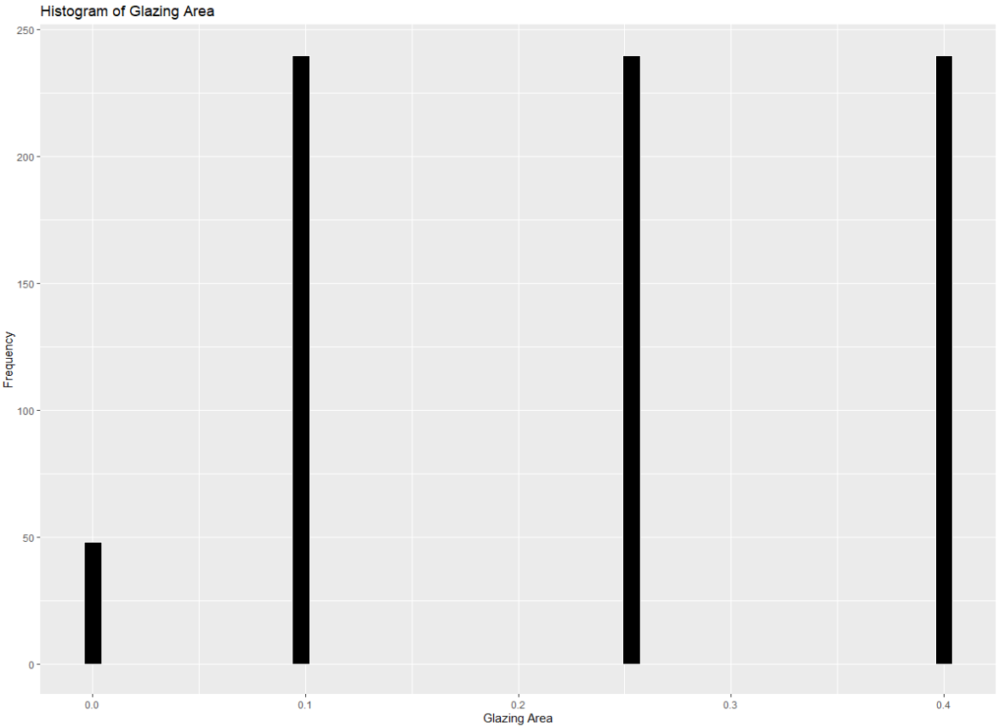

Slide 13

Statistical Analysis

Slide 14
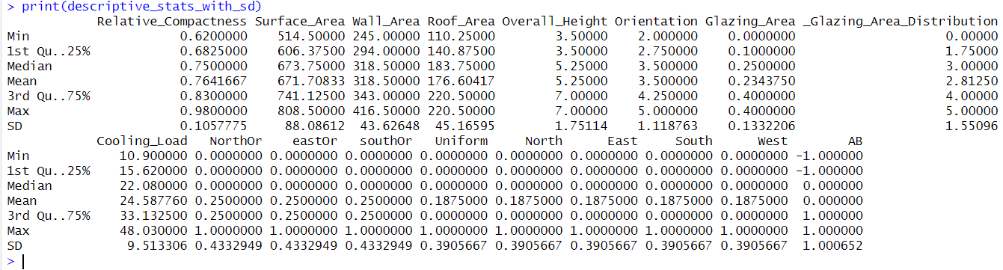
Descriptive Statistics
Let's interpret some of the key variables:
Relative Compactness: Ranges from 0.62 to 0.98, with a mean of approximately 0.76.
Surface Area: Varies from 514.5 to 808.5 with a mean of approximately 671.7.
Cooling Load: The dependent variable of interest, ranging from 10.90 to 48.03 with a mean of about 24.59.

Slide 15
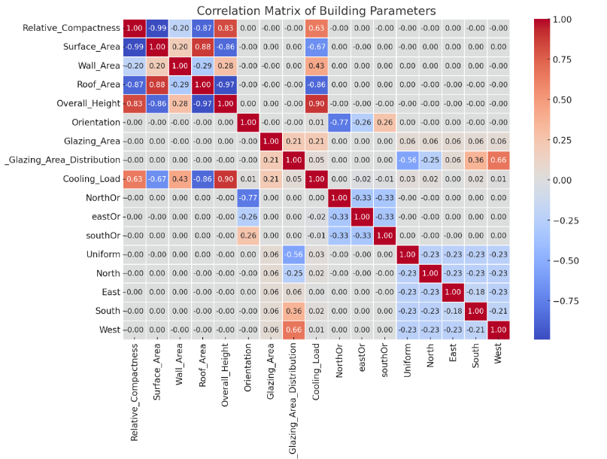
Correlation
Relative_Compactness has a strong negative correlation with Surface_Area (-0.99), which suggests that as the relative compactness increases, the surface area decreases, and vice versa.
Overall_Height shows a very strong negative correlation with Roof Area (-0.97), indicating that buildings with greater height tend to have less roof area.
Cooling_Load is strongly negatively correlated with Surface_Area (-0.67) and positively correlated with Relative_Compactness (0.63) and Wall_Area (0.43), highlighting their importance in predicting the cooling load of a building.

Slide 16
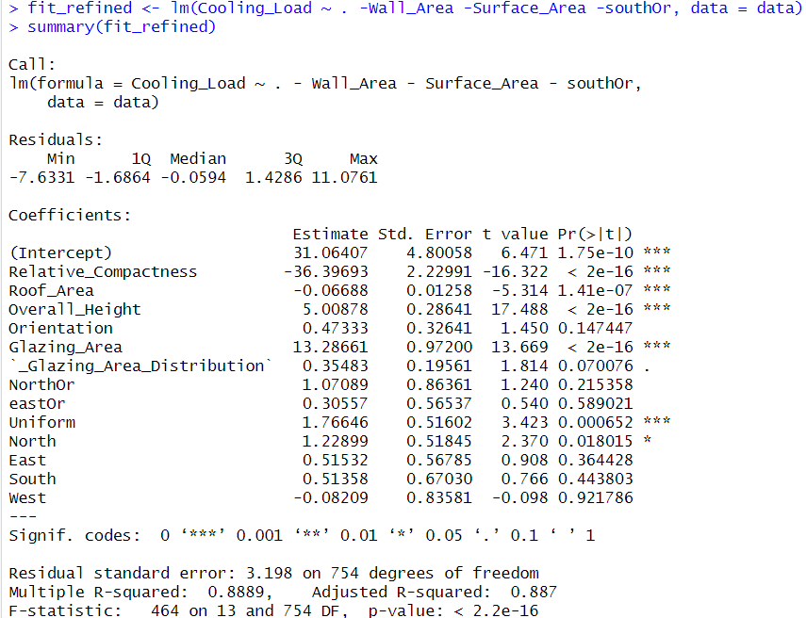
Linear Regression
Accuray: 0.887 indicates that approximately 88.70% of the variance in the cooling load can be explained by the model's predictors.

Slide 17
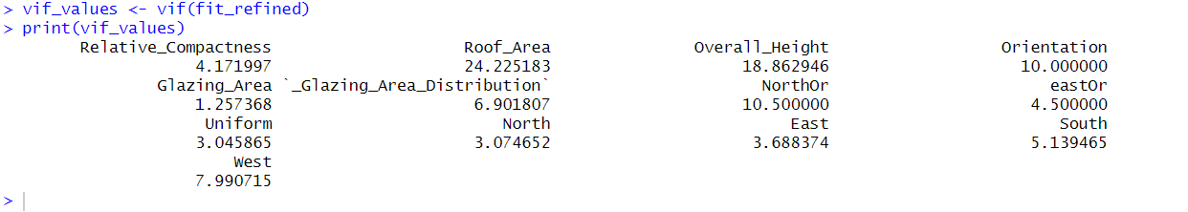
VIF Analysis
The VIF results suggest that "Roof Area" and "Overall Height" have high multicollinearity, with VIFs of 24.23 and 18.86, respectively.
"Orientation" also shows potential multicollinearity with a VIF of 10.
Variables like "Glazing_Area_Distribution" and "NorthOr" have moderate VIFs above 5.
Meanwhile, "Relative Compactness" and direction-based variables ("Uniform," "North," "East," "South," "West") have VIFs below 5, indicating less concern for multicollinearity.

Slide 18

Modeling Analysis

Slide 19
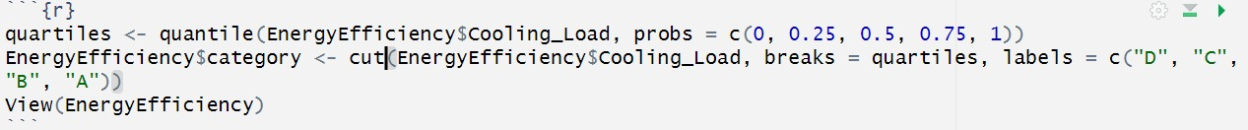
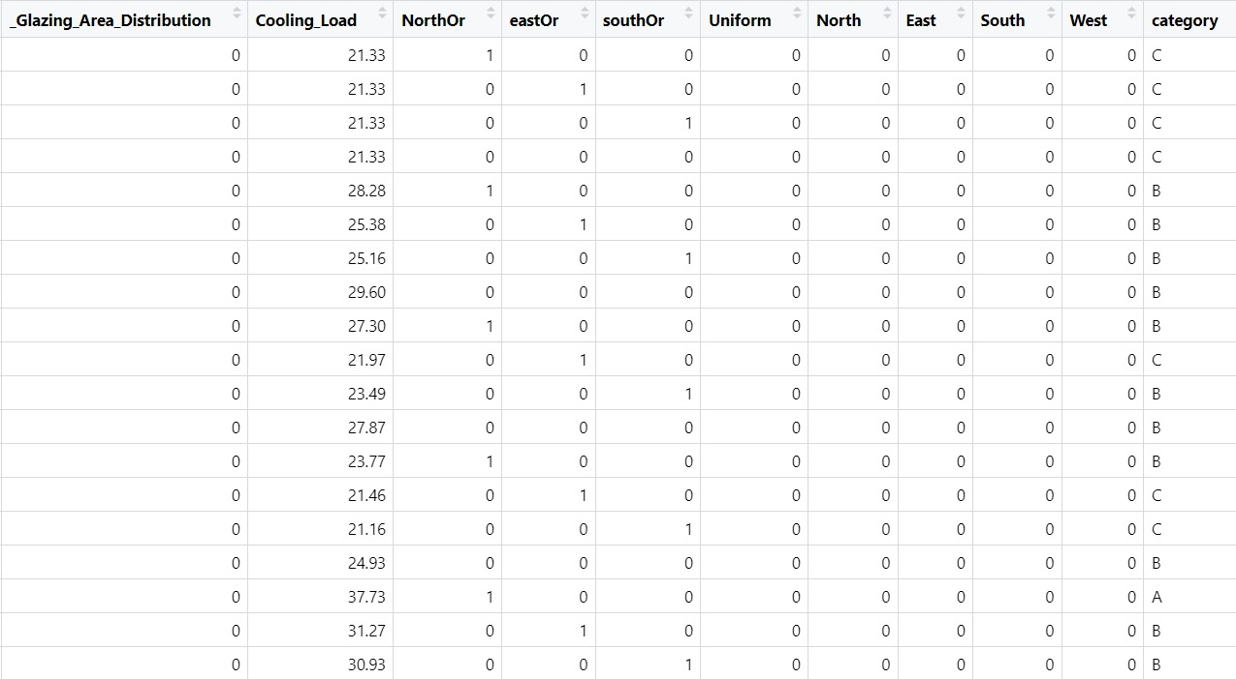

Slide 20
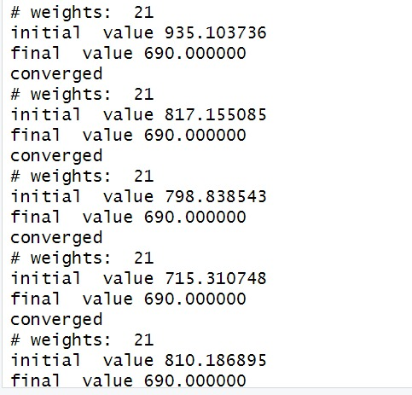
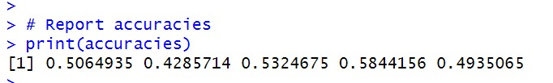
Perceptrons
The model is having highest accuracy of around 58% where the predicted initial values is 715 and the final value predicted after learning from data is 690

Slide 21
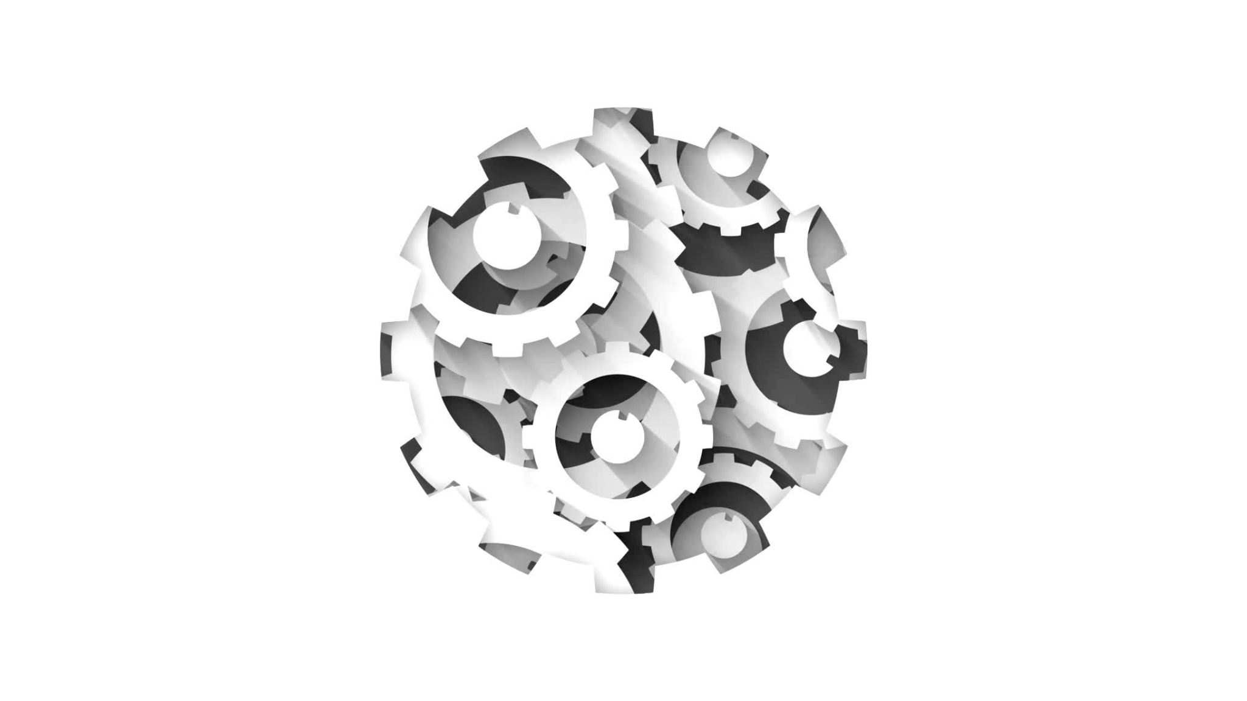
Support Vector Machines

Slide 22
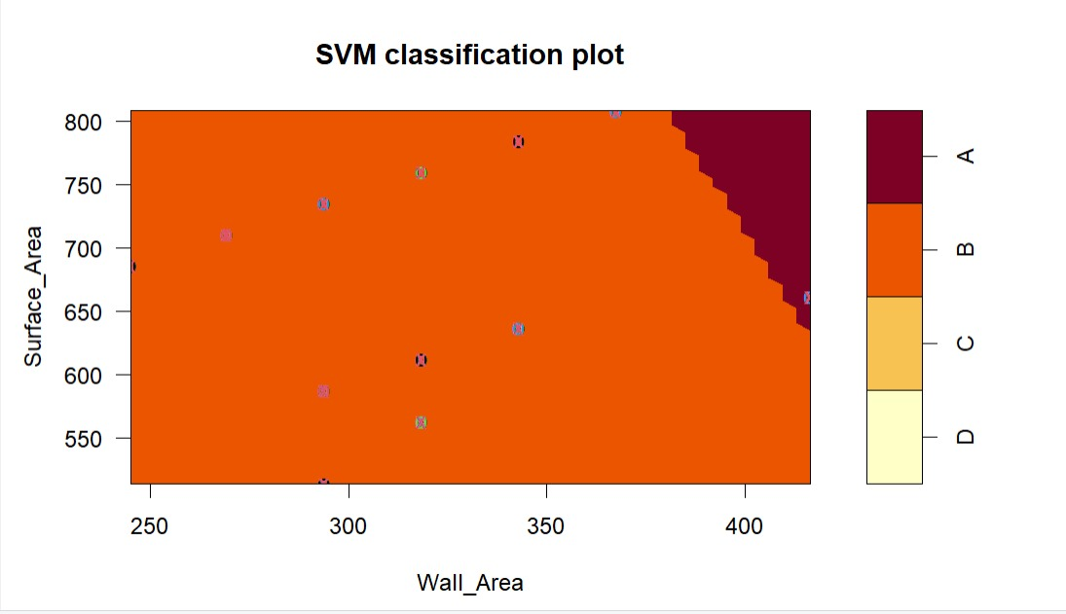
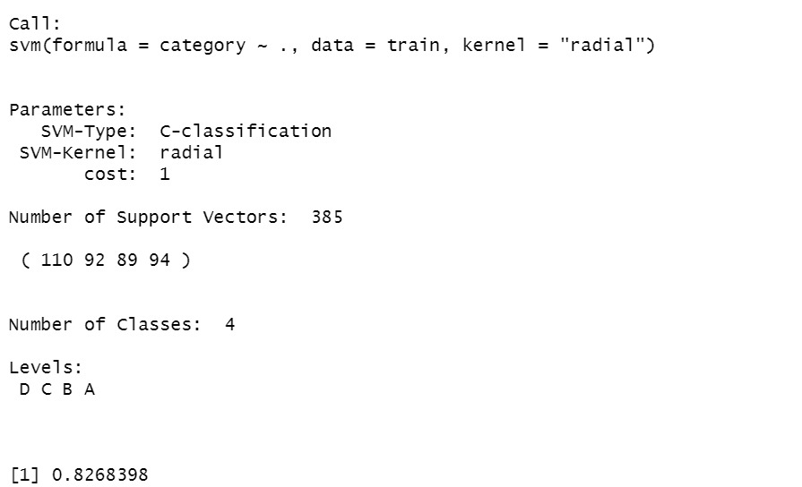
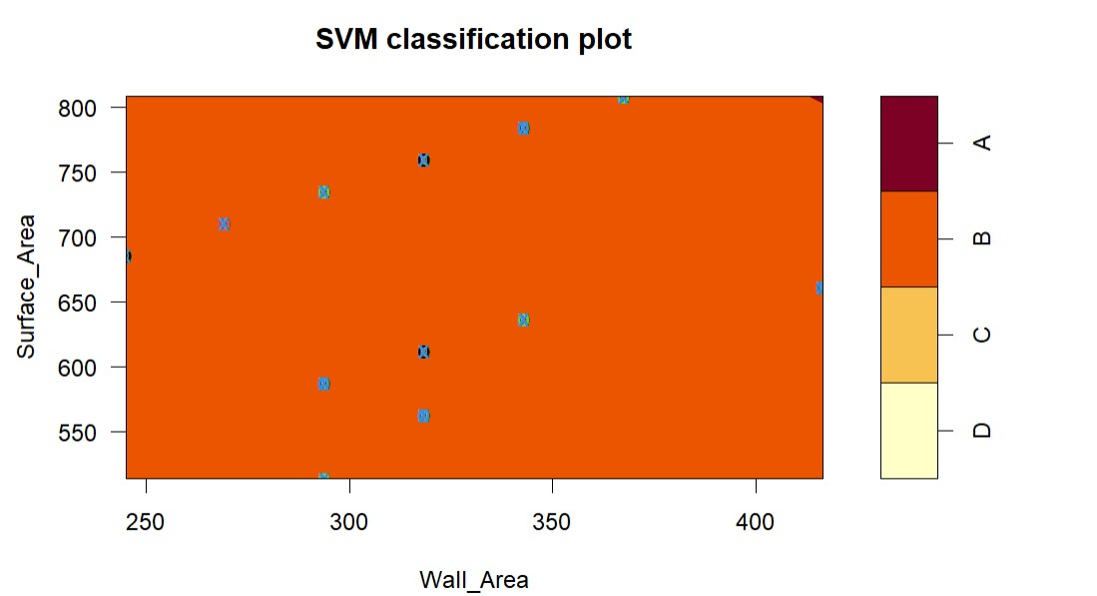
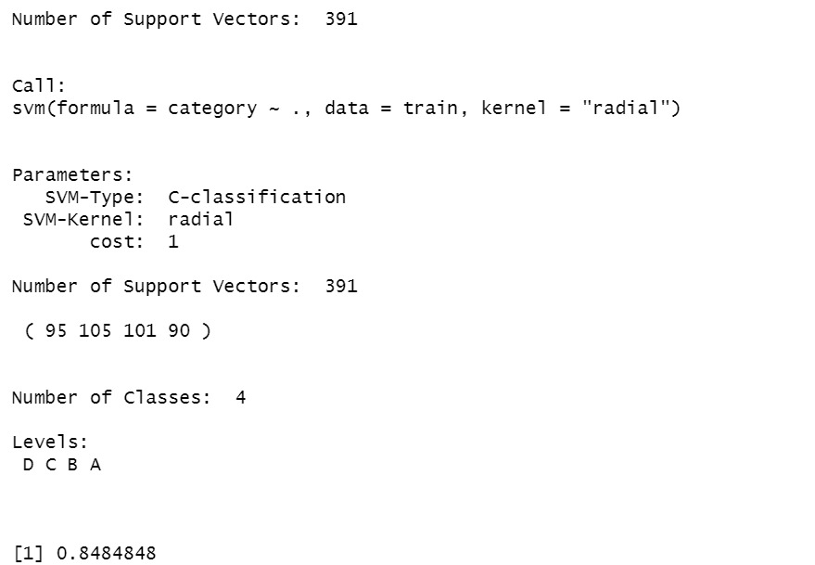

Slide 23
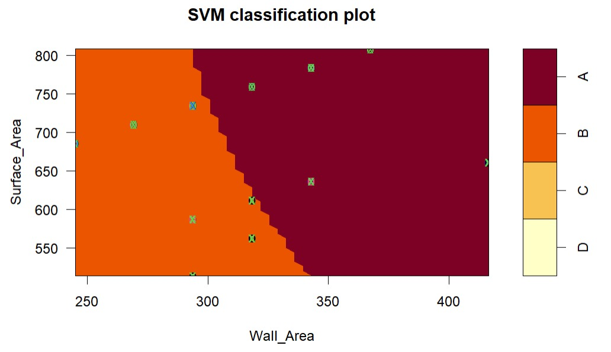
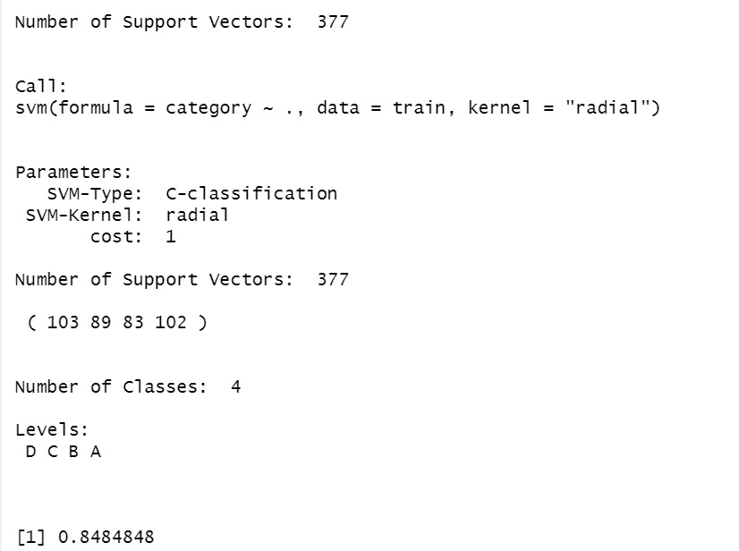
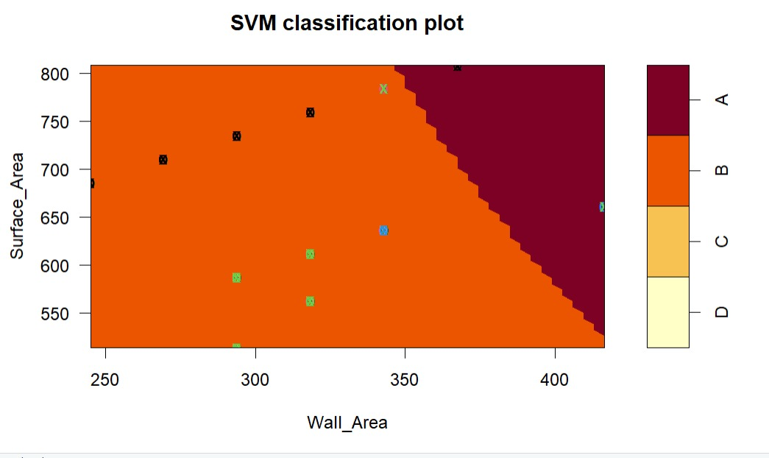
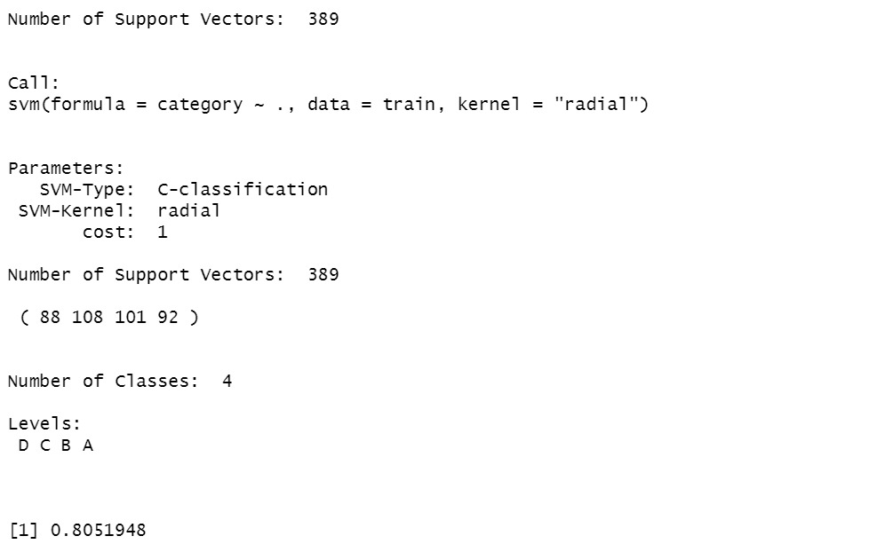

Slide 24
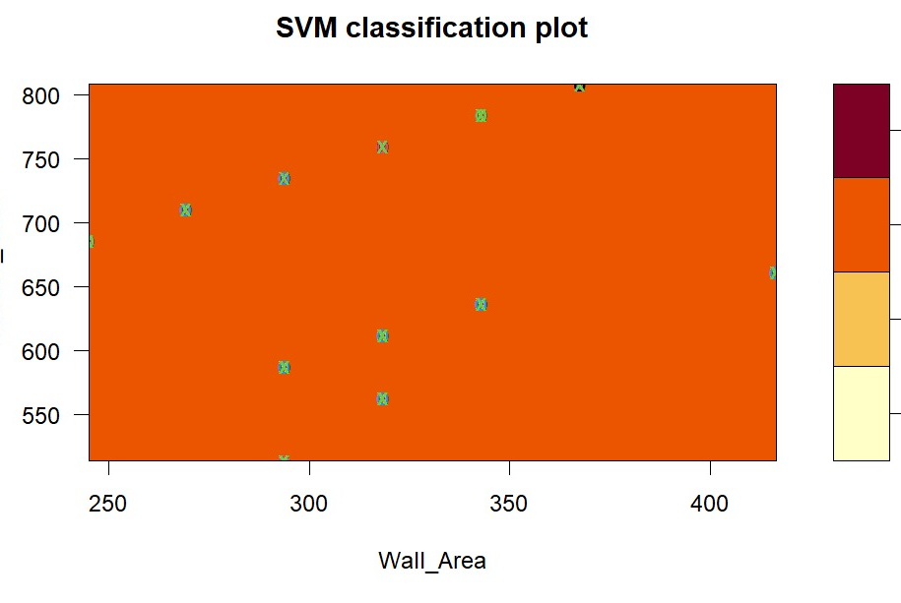
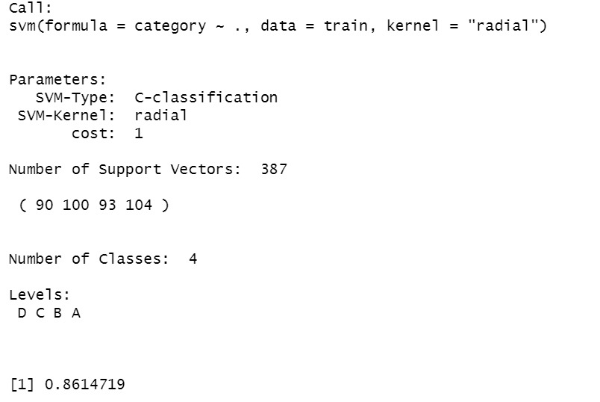

Slide 25
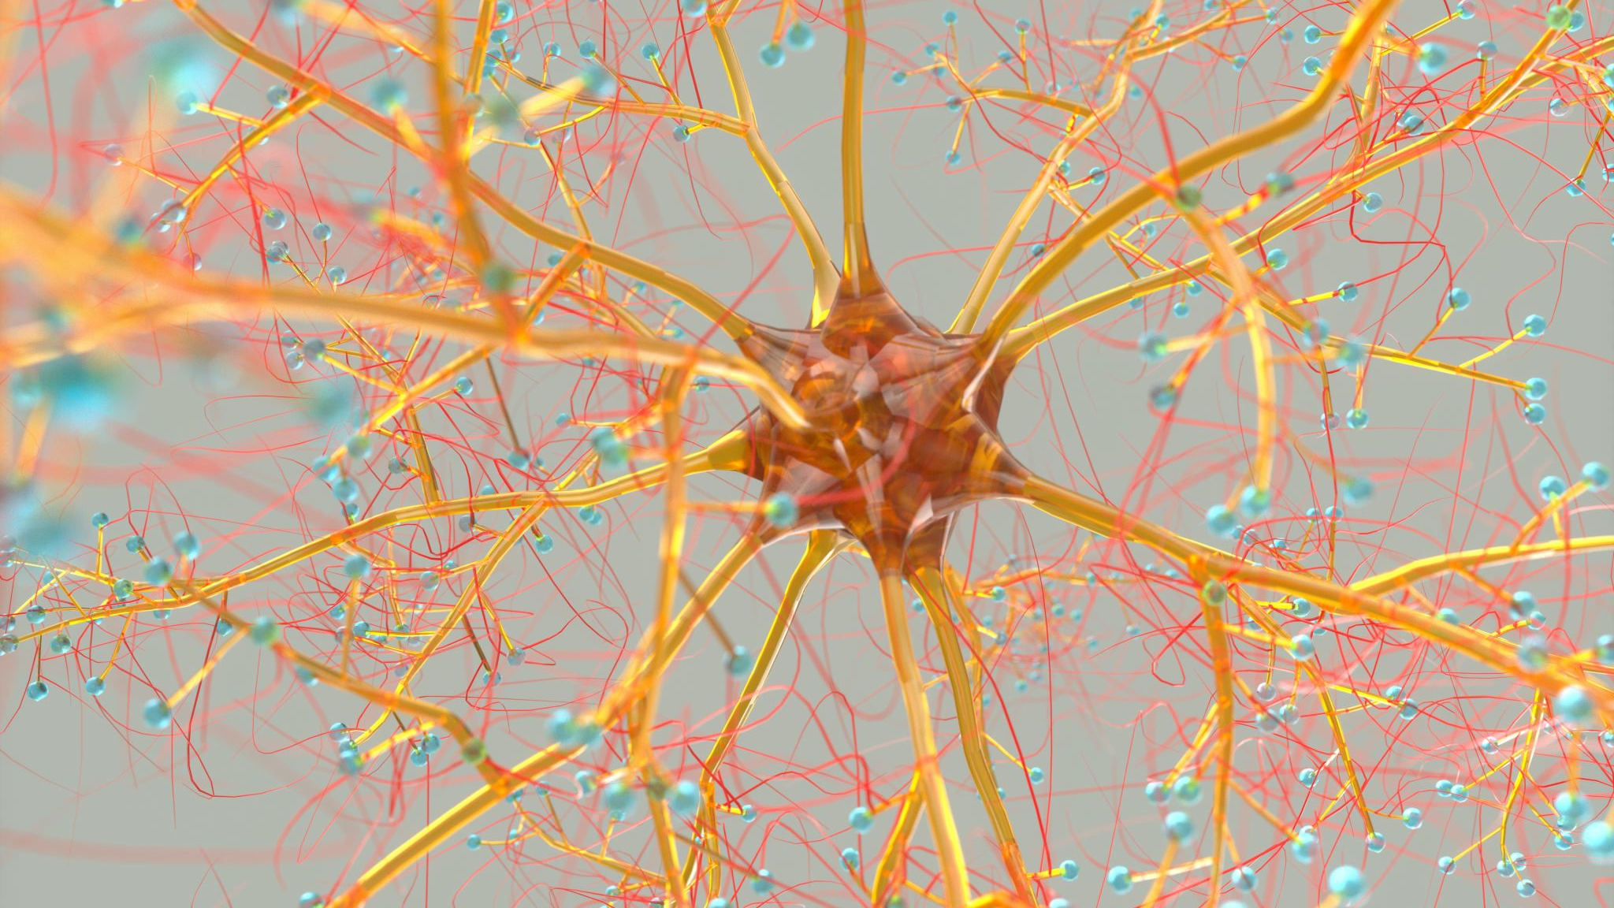
Neural Networks

Slide 26
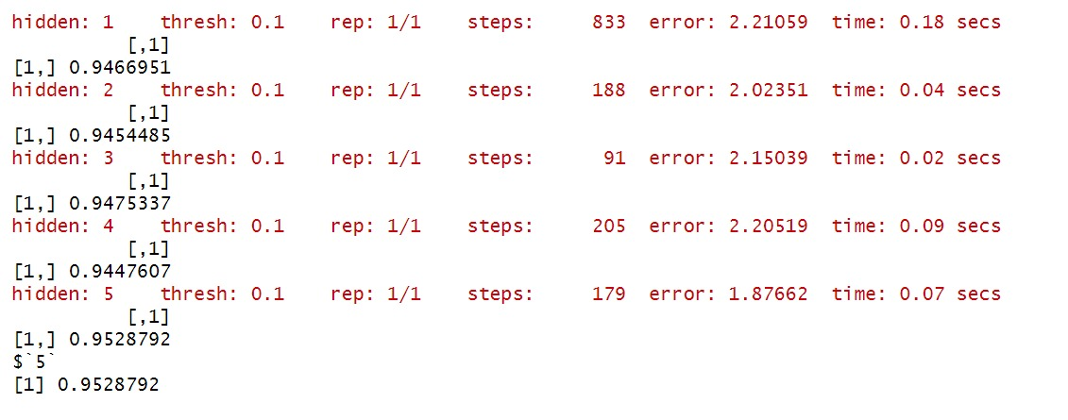

Slide 27
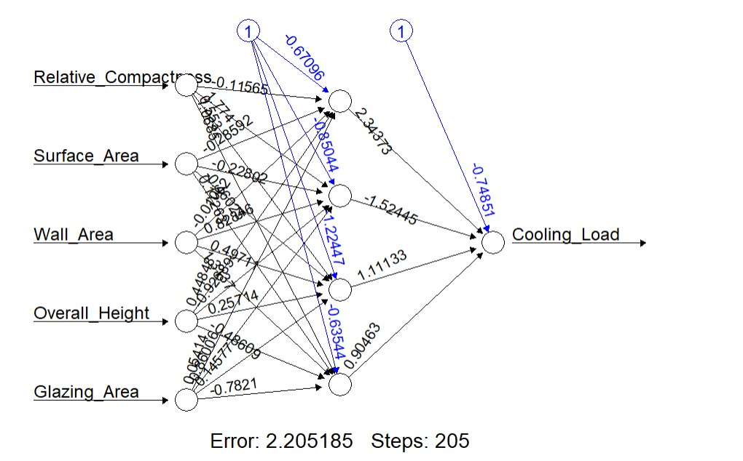
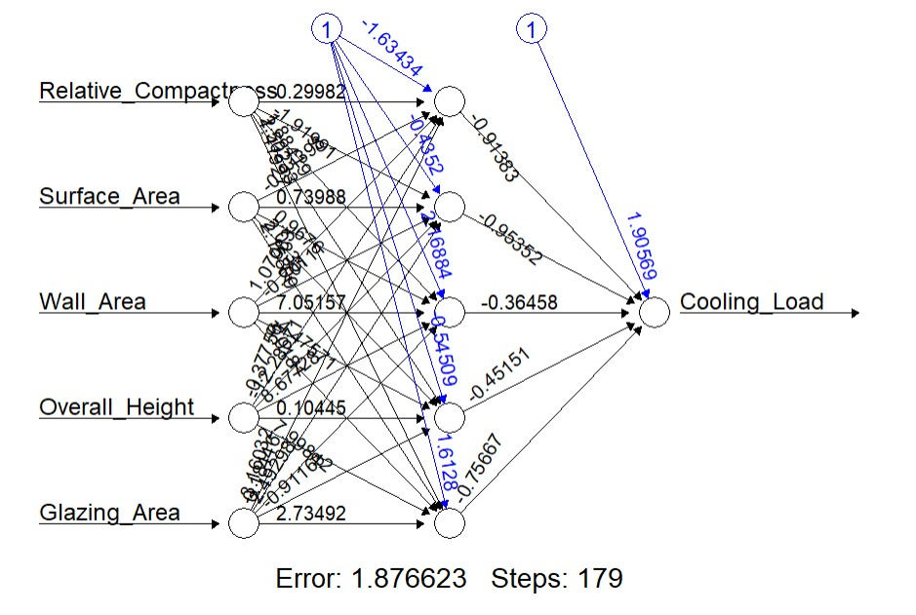

Slide 28
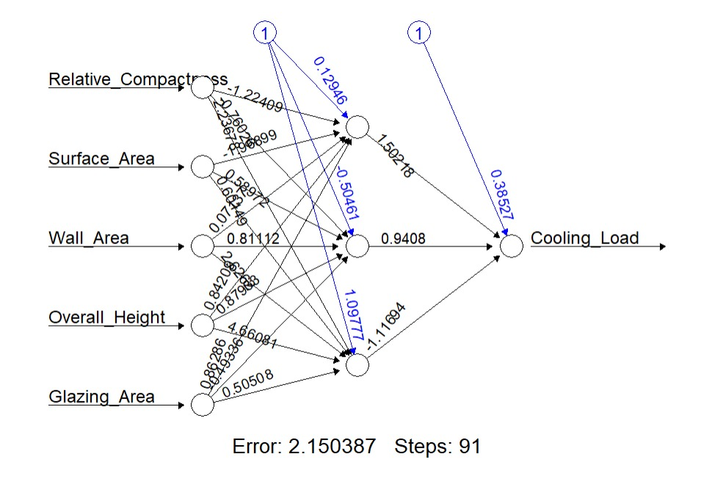
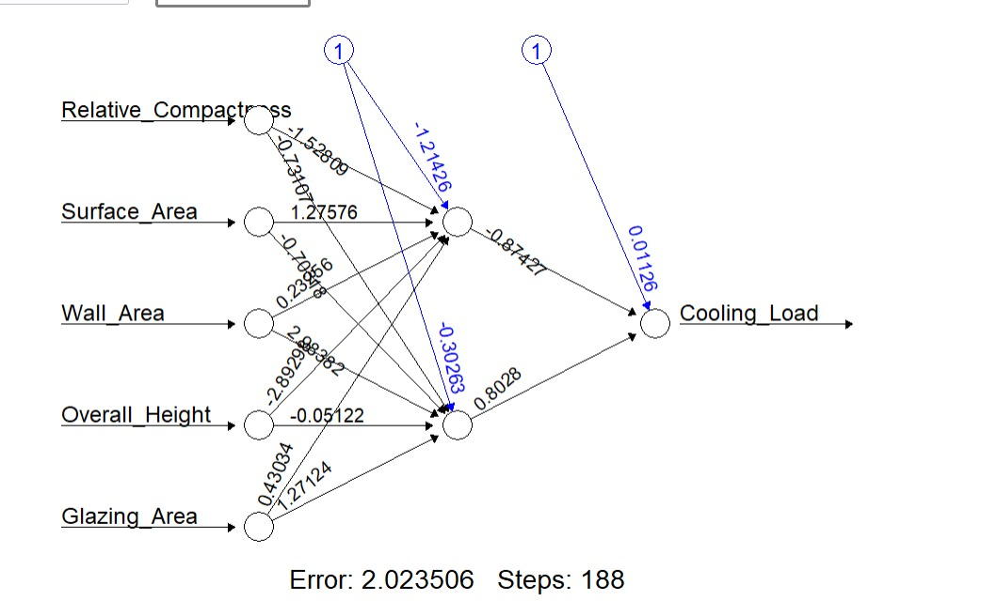
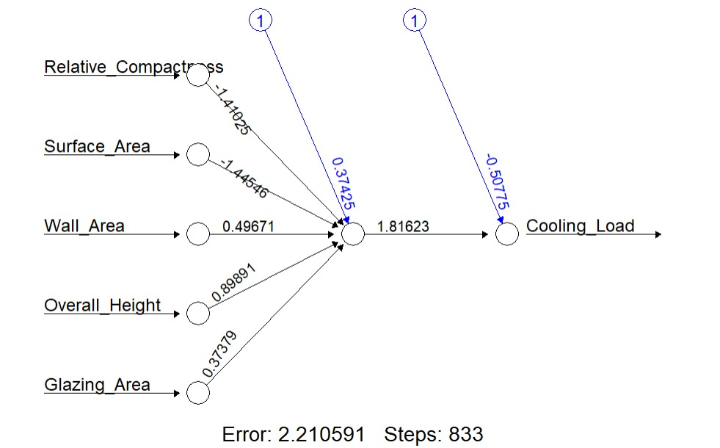

Slide 29
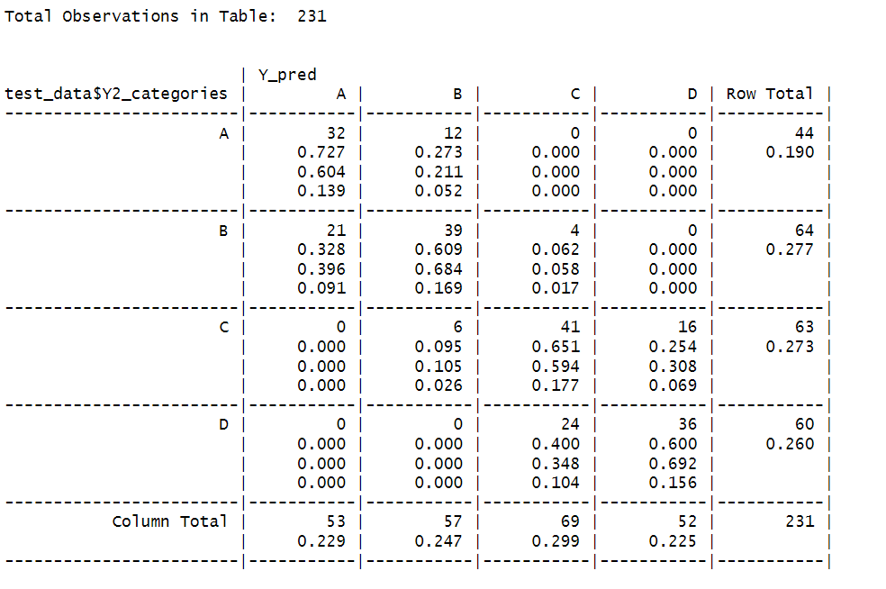
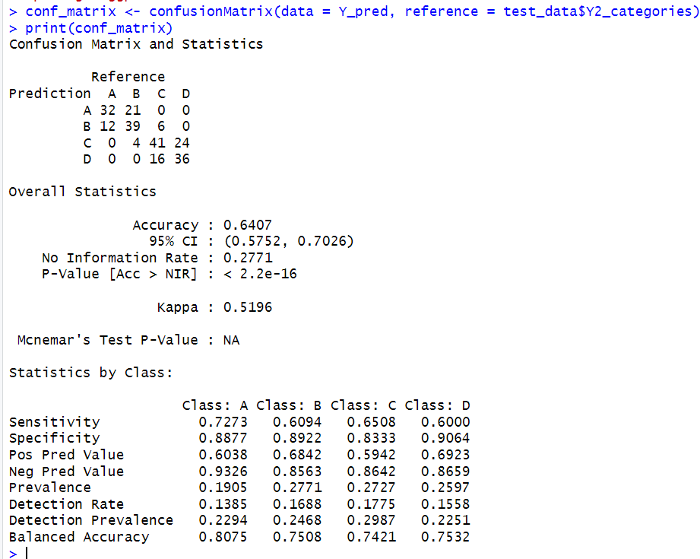
K-nearest neighbor analysis-1

Slide 30
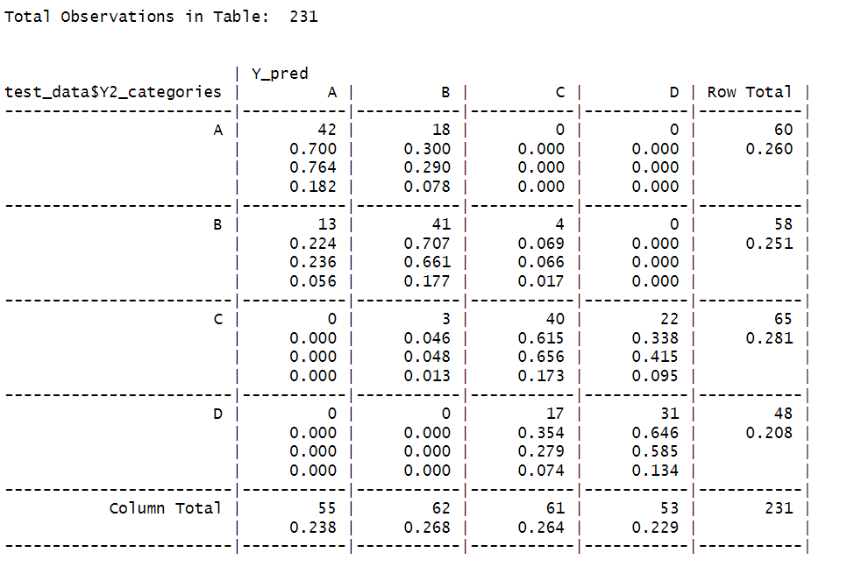
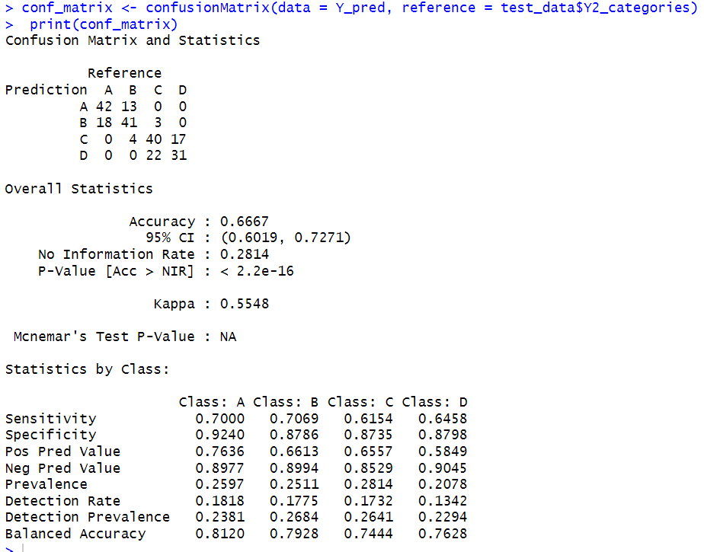
K-nearest neighbor analysis-2

Slide 31
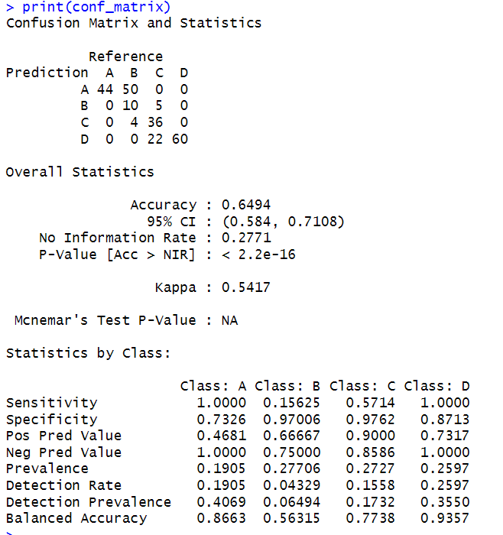
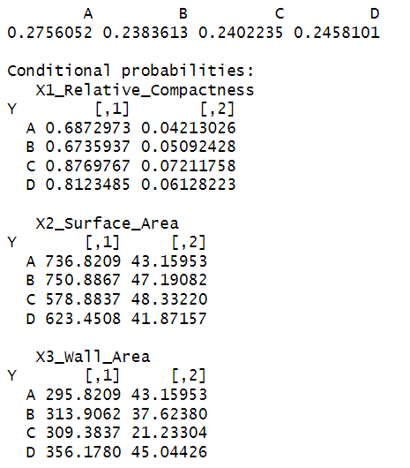
Naïve Bayes analysis-1

Slide 32
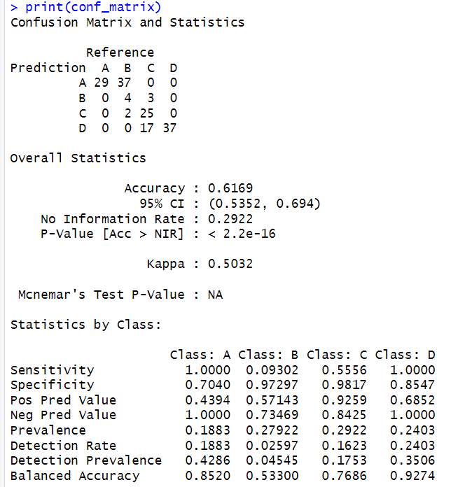
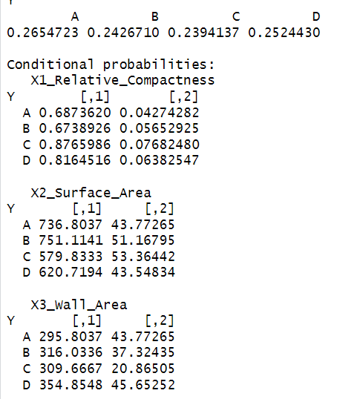
Naïve Bayes analysis-2

Slide 33
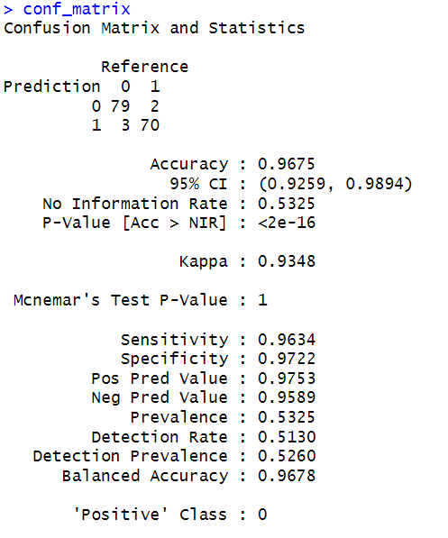
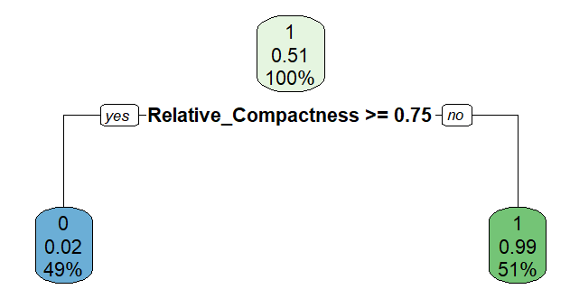
Decision Tree

Slide 34
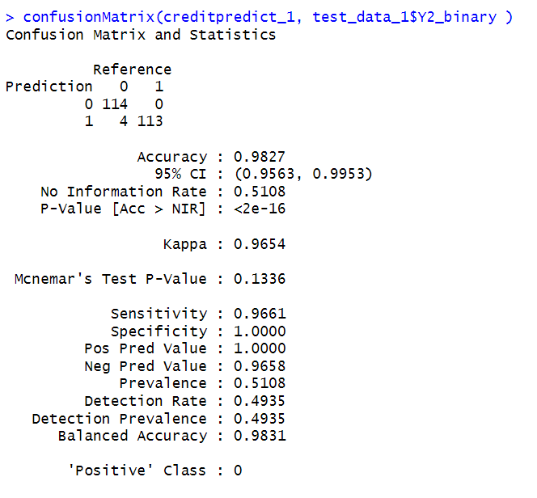
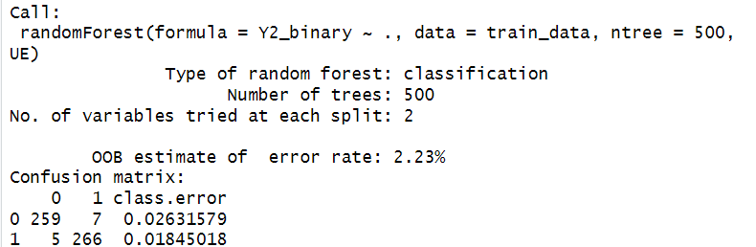
Random Forest

Slide 35


Boosting

Slide 36
PREDICTION POWER
Perceptron | Accuracy
Model-1 | 0.5064
Model-2 | 0.4285
Model-3 | 0.5324
Model-4 | 0.5844
Model-5 | 0.4935
SVM | Accuracy
Model1 | 0.8268
Model2 | 0.8484
Model3 | 0.8614
Model4 | 0.8051
Model5 | 0.8484
Neural Networks | Accuracy
1 Hidden Node | 0.9466
2 Hidden Nodes | 0.9454
3 Hidden Nodes | 0.9475
4 Hidden Nodes | 0.9447
5 Hidden Nodes | 0.9528
K-nearest neighbor | Accuracy
Model-1 | 0.6407
Model-2 | 0.6667
Naïve Bayes | Accuracy
Model-1 | 0.6494
Model-2 | 0.6191
Decision Trees | 0.9675
Random Forest | 0.9827
Boosting | 0.9654

Slide 37
Random Forest was the technique that gave us the best result with an accuracy of 98.27, Followed by decision tree giving 96.75% accuracy.
Relative compactness of a house followed by glazing area and wall area are playing a major role in increasing the cooling load of a house, having an eye on these parameters can help Builders in making energy efficient buildings

Slide 38
Thank you

